Slide 1
PINBALL MACHINE DEVELOPMENT NOTES
EPIC Robotz, Fall 2022 Project

Slide 2
AC Wiring
Otherwise known as “Mains” Wiring

Slide 3
110 Volt AC Line Items
Power to the main 20-48 Adjustable Supply for Magnets and Coils
Power to 12 Volt Supply for high powered LEDs
Power to 5 Volt Supply for Raspberry, Logic, and NeoPixel LEDs
Power to 17” Monitor used as the Score Board

Slide 4
Questions to Resolve
Requirements:
One ON/OFF switch for entire machine.
One AC power cord to outlet on a wall to power entire machine.
Questions:
Where should the On/Off switch be mounted?
Do we need a fuse? If so, where should it be mounted?
How should the power be routed to various components?
Use Power Strip and Multiple AC cords inside of machine?
Or use terminal screw strip and route AC power over custom wires?

Slide 5
Controlling Magnets and Coils

Slide 6
List of High Voltage Magnets and Coils
Feature | Number | Coil Resistance | Coil Windings | Amps @ 48v
Flippers | 3 | 3.3 / 350 | 25-500 / 34-4500 | 14.5
Bumpers | 3 | 11.2 | 26-1200 | 4.2
Kickers | 3 | 4 | 023-800 | 12
New Ball Kicker | 1 | 4 | 023-800 | 12
Dropped Ball Kicker | 1 | 4 | 023-800 | 12
Replacement | 0 | 14.25 | 26-1500 | 3.4
Total Circuits | 11

Slide 7
Direct Control vs Computer Control
Direct Control:
Current runs though “switch” directly to Coil.
Switch is physically closed by human or pinball
Switch must be rated for high current
By itself, computer does not know about switch closure, and therefore cannot score or make sounds
High current must be limited by circuit design
In old pinball machines, this design was only choice since there were no computers.
Computer Control:
The computer has ability to fire the coil anytime it wants
The computer reads switch inputs and decides when the coil should be fired.
Using PWM, the computer can change the strength of the coil magnet, and limit current.
The sensing switches can be driven with very low current and voltage, so they can be much smaller.
Scoring is easy, just becomes a software issue
Downsides:
The computer must respond fast enough so that any delay in coil activation does not change gameplay. (Flippers, Kickers, Bumpers, etc)
A special computer-controlled switch is needed for each coil. (We use MOSFET switches)

Slide 8
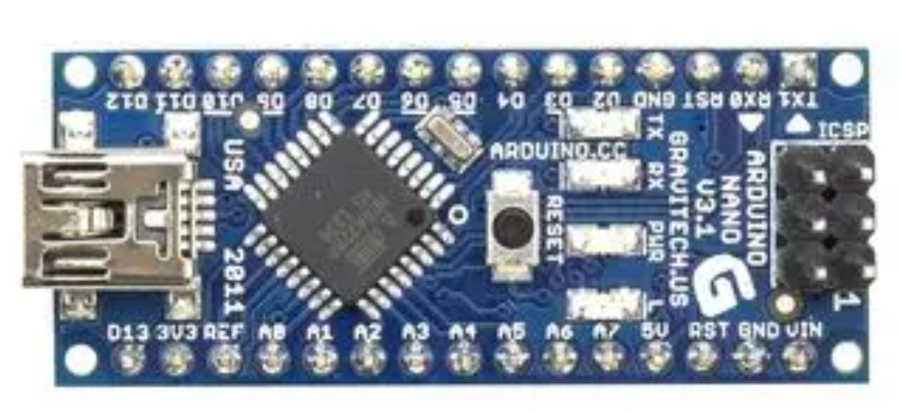
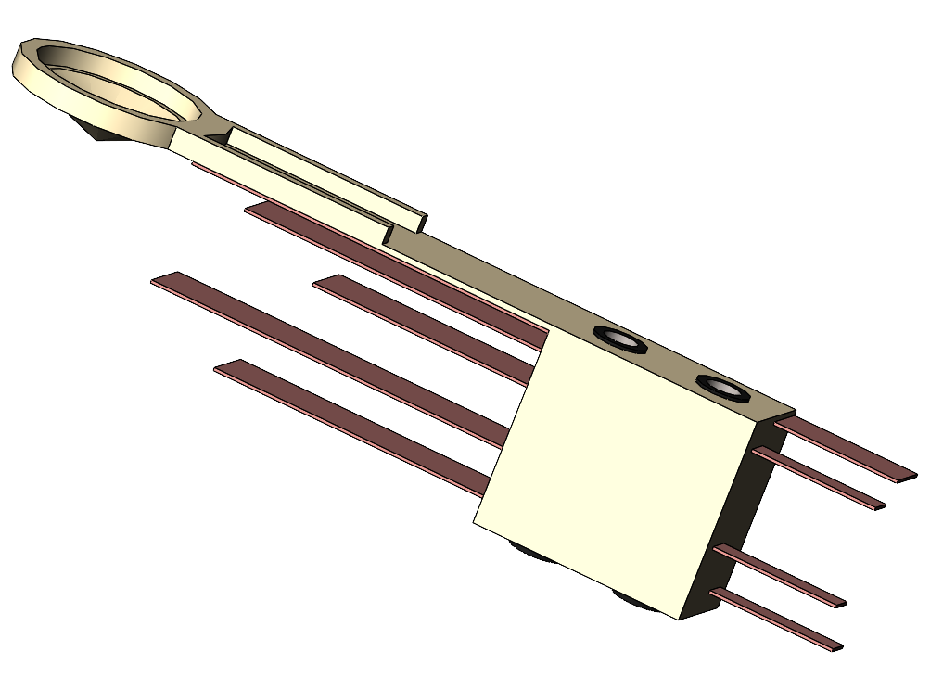
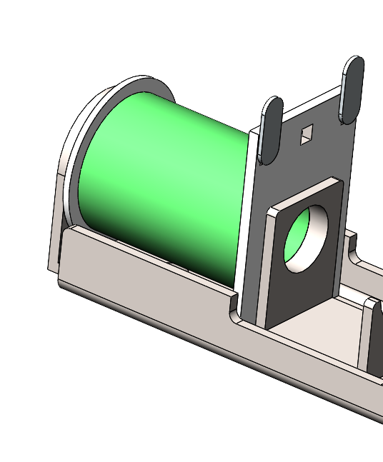
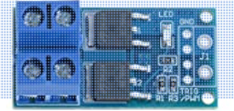
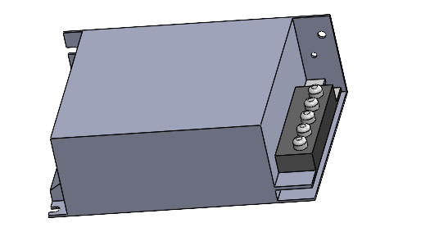
Typical Coil Wiring
Computer – Could be a Arduino Nano (as shown) or Raspberry Pi, or ?
Switch Input
Sensor Switch
Control Output
Ground
Solenoid Coil (which creates a strong magnetic force)
Ground
“Flyback” Diode, to protect the MOSFET switch when the current is turned off after being on.
MOSFET Switch. The device shown is rated up to 36 volts and 10 Amps. For higher voltage a custom circuit needs to be built.
High Voltage Power Supply, 12-48 volts

Slide 9
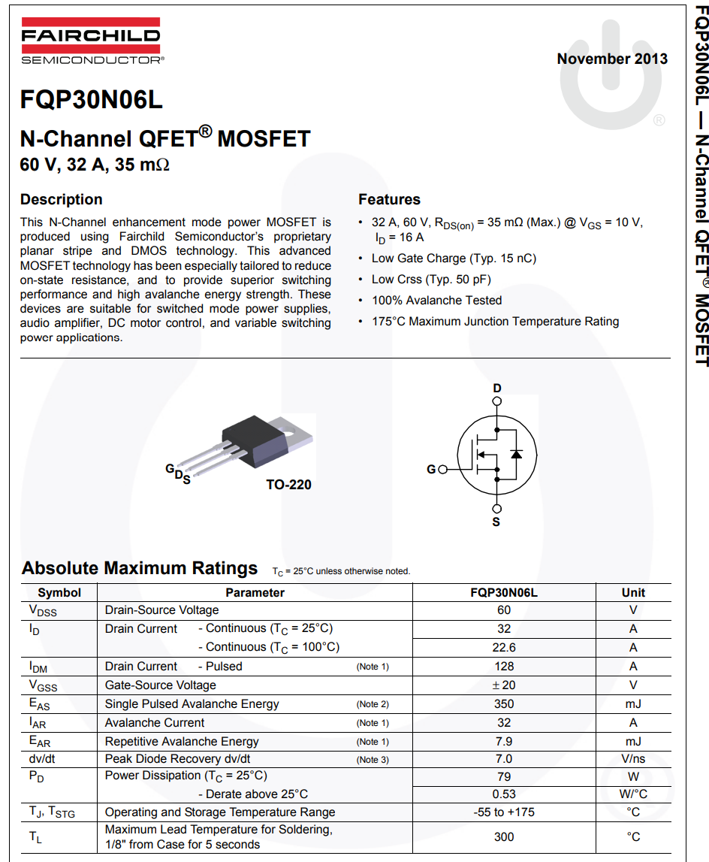
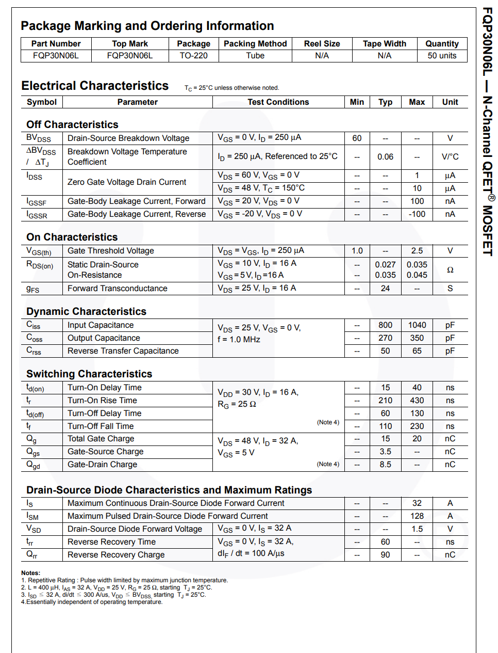
MOSFET for Coil Switch: FQP30N06L
Important Parameters:
60 Volts
32 Amps
.045 ohm On State Resistance
About $1.00 each

Slide 10
Building a MOSFET Switch
FQP30N06L
For MOSFET to work reliably,
>4 volts needed for control.
We should be okay.
(Diode MUST
Be wired in place, or
MOSFET might be destroyed.)
G
D
S
(Resistor Network
Saps off 0.2v)
100
From Microprocessor
+5v = On
0v = Off
(Arduino Nano delivers
Close to these voltages)
100K
Gnd
+ 48v

Slide 11
Experiments for Computer Control

Slide 12
Control Questions
What Electrical Architecture should be used to respond quickly to sensor inputs?
It a cheap Arduino Nano ($2.00 each) fast enough for our needs?

Slide 13
Computerized Control Test
Testing ability of microprocessor to be in full control of solenoid
Wrote NanoMagTest
Had following states:
READY – fires the solenoid on switch closure
FIRING – Holds the solenoid down for 100 msec
STUCK – Comes here after FIRING if switch is still closed. Waits for switch to open.
RESTING – comes here after FIRING or STUCK to “rest” before allowing another cycle… Rest time was 80ms
Observations:
Seems to work.
Sometimes gets untriggered double strikes
Shaking and vibration of table is causes fires… Solve that with sturdy table?

Slide 14
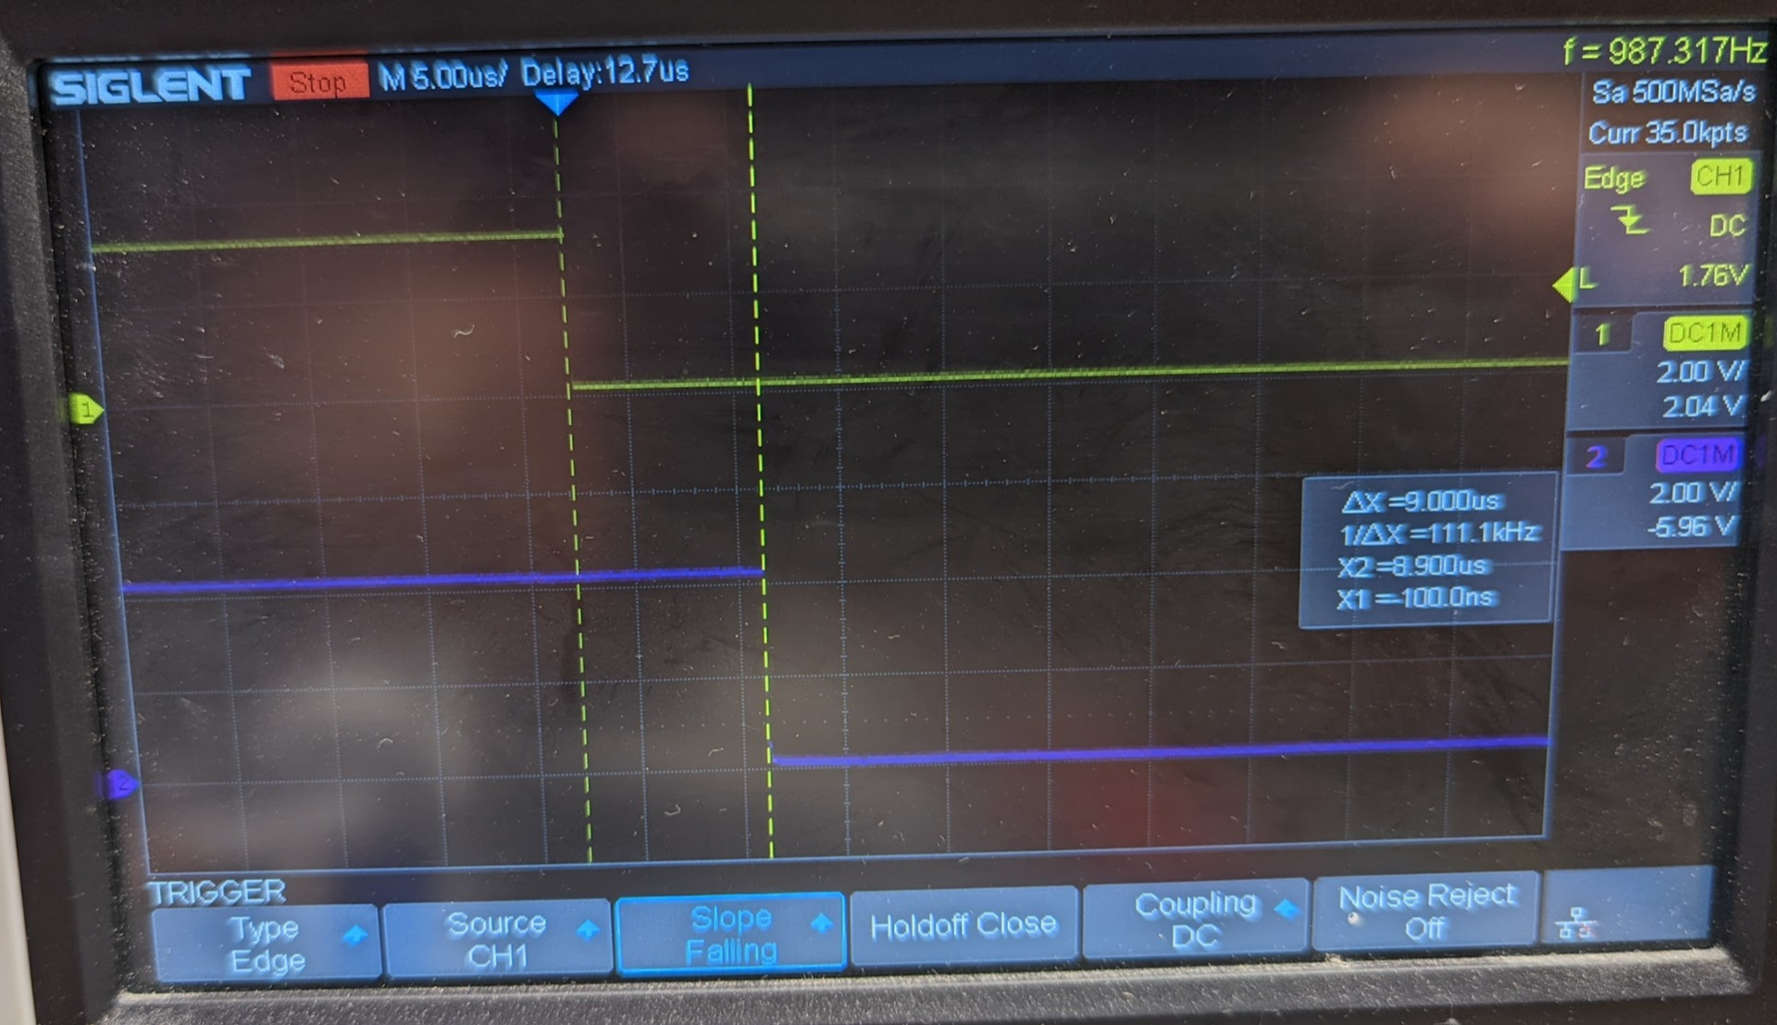
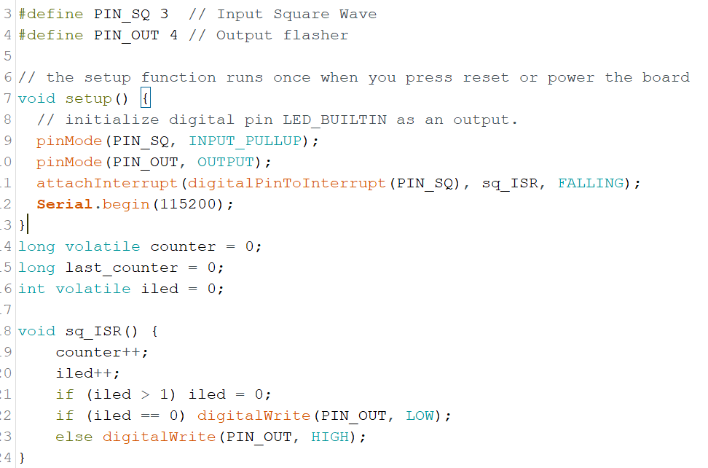
Response Time Test
Measure time to respond to interrupt on Pin 3 of NANO
Looks like about 9 uses.

Slide 15
Notes on Ardunio NANO @ 16 MHz
Max out square wave: 113 Khz, 8.8us
Two Digital Write Calls in a while(true) loop.
A NANO should execute 16 instructions every 1us.
The argues that the C loop generated about 8.8*16 = 140 Instructions!
(Same code should be about 10 instructions in assembly language, or over 1MHz square wave).

Slide 16
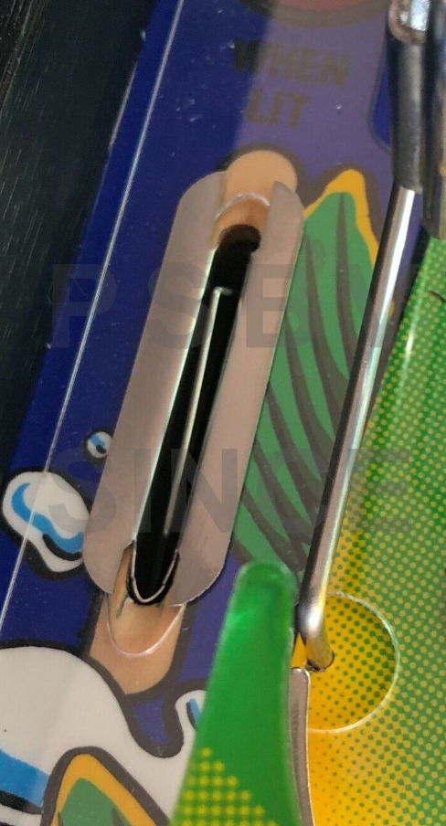
Slot Switches
Senses when ball rolls through a slot

Slide 17
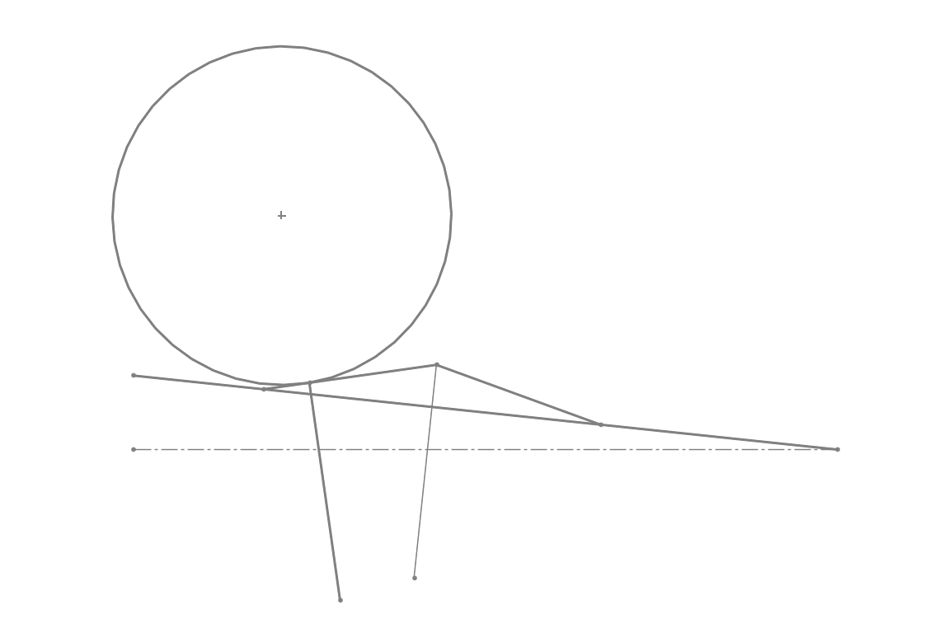
Force Calculation
Assume Best Case: weight of entire ball presses down at right angle to flat, horizontal surface where the switch is located.
Weight of ball is about 0.15 pounds, or about 2.4 oz, or about 68 grams
Therefore, to account for misalignment, slope of table, and angle to where the force will be applied, assume we want an activating force of about half the weight of the ball, or about 34 grams, or 0.034 kg.
1 Newton of Force is 9.8 kg of mass.
Our Max Force = 0.034 * 9.8 = 0.33 Netwons
Note, also, we don’t want to slow the ball down or change its direction to activate the switch.
Pinball
Lever Wire
Playing Surface at
6 degrees slope
Possible force vectors

Slide 18
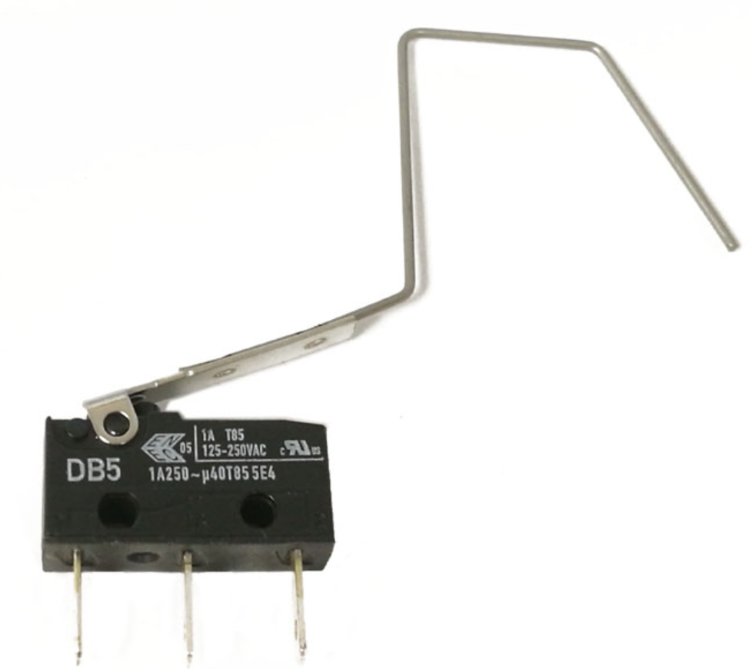
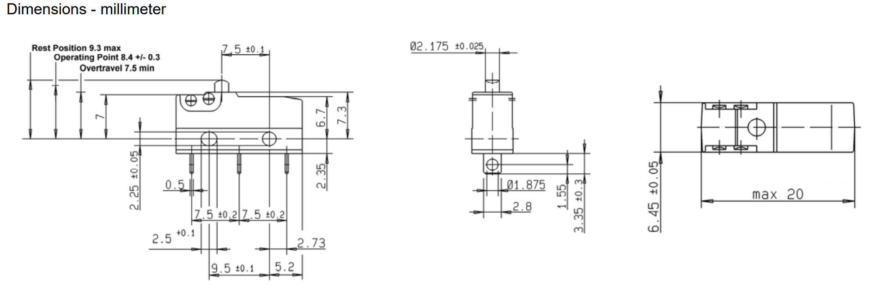
Old Machines, How They Did It
Williams/Bally Sub-Microswitch
About $5.00 each
Appears to have spot welded paper clip wire
More Info on DB5 Switch
Made by CHERRY
Datasheet: https://www.farnell.com/datasheets/1641341.pdf
Hard to Tell, but Operating Force seems to be about 0.50 N

Slide 19
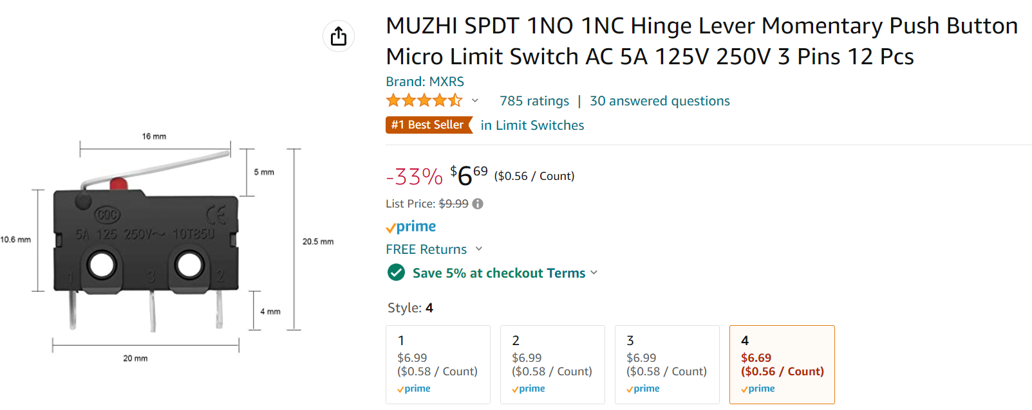
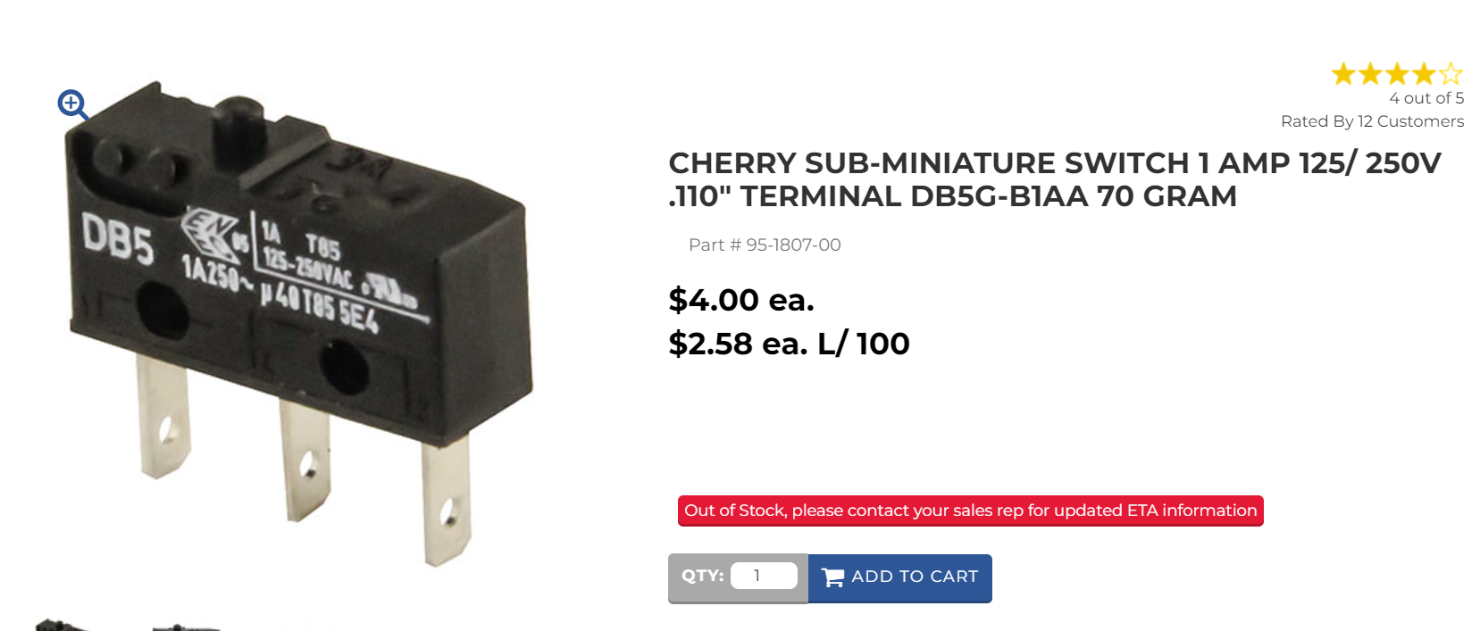
Possible Substitute Switches
I believe that this is the present-day raw switch that the original pinball machines used.

Slide 20
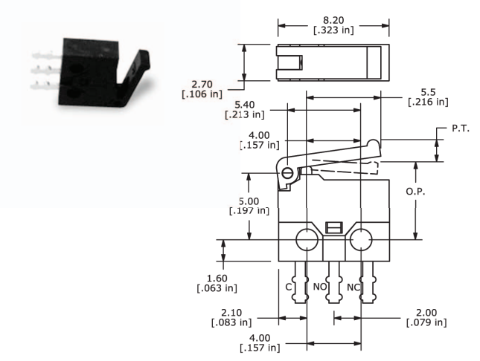
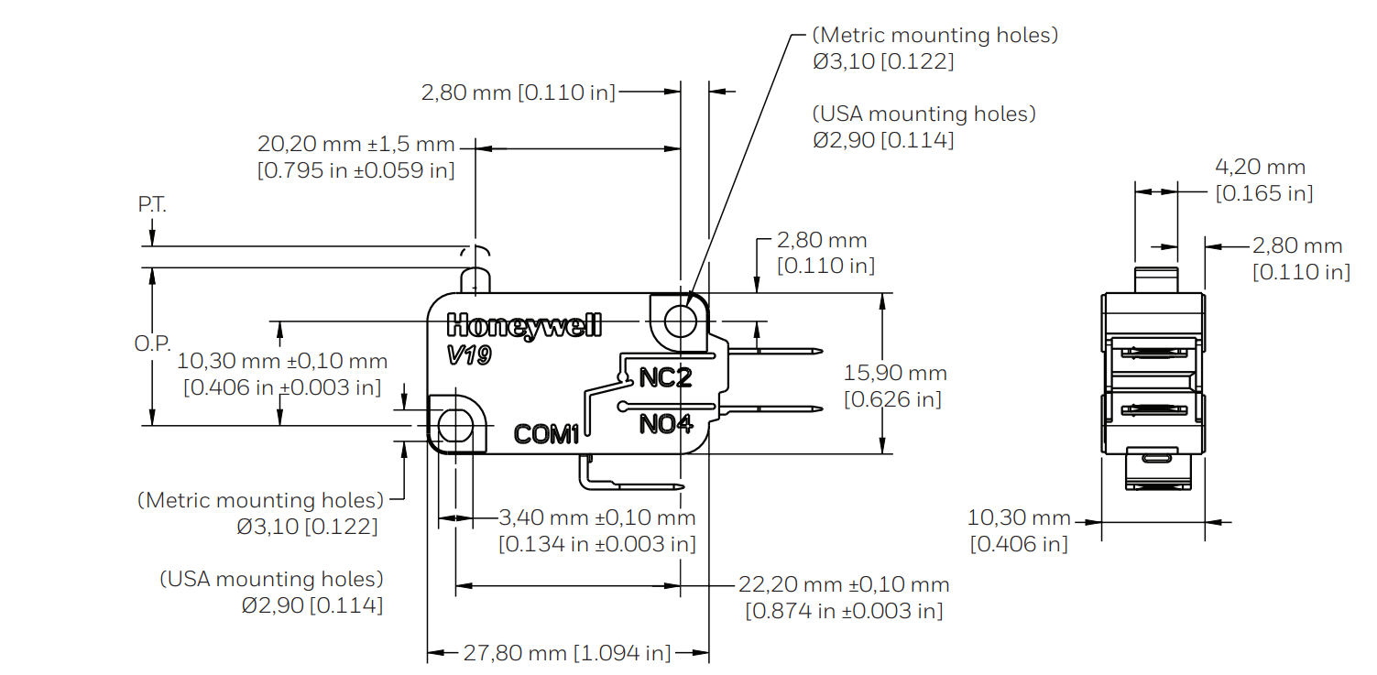
DigiKey Switches
V19S05-HZ015A03
0.15 Netwons of force, or 15 grams of force
Lever Far from Plunger
3.1mm Mounting Holes
$1.93 each
Plunger Travel: 9 + 3.8 + 2.0 mm
TS0101F020V3
Made by E-Switch
Only rated for 6v @ 0.3 amps
20 grams (+/- 10g) operating force
PCB terminals – must be soldered
About $1.00 each

Slide 21
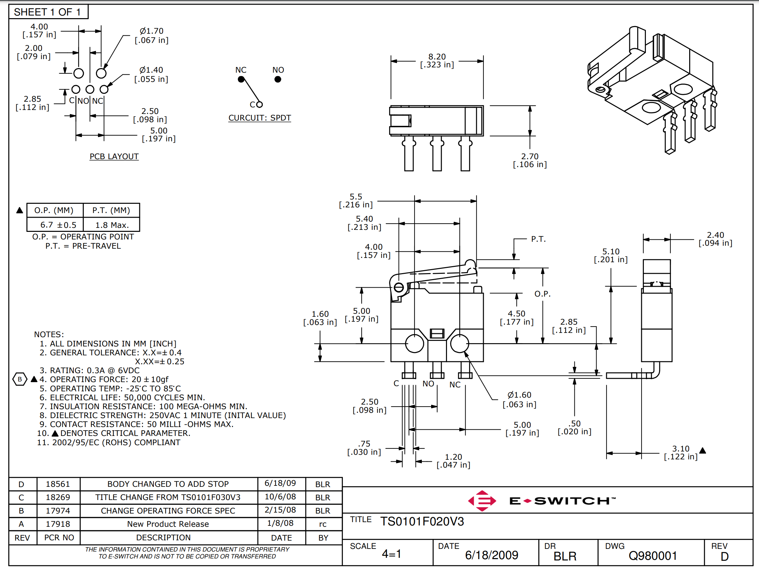
Micro Switch: TS0101F020V3
Most Promising

Slide 22
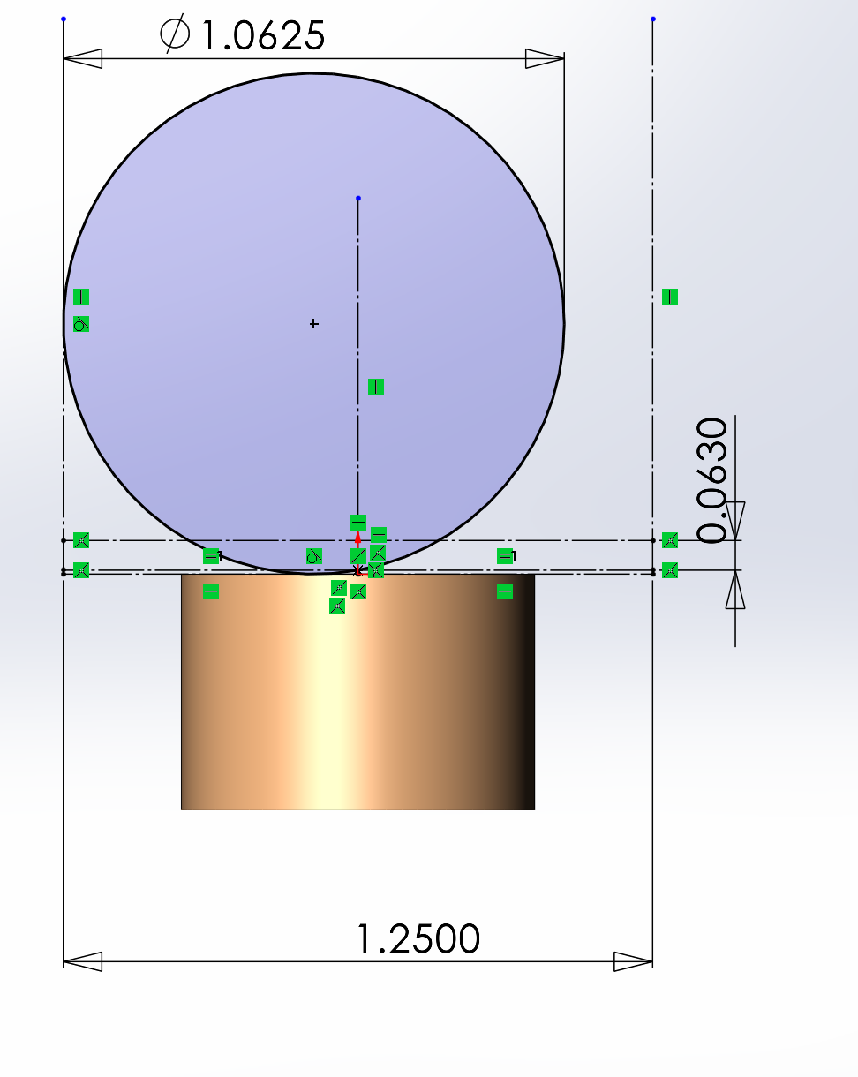
Drawing Showing that TS Micro Switch can Work
Slot Wall
Slot Wall
This shows that the switch should be activated even when the pinball is traveling against the slot side wall.
Line of Switch Activation
Pinball
Switch Mount

Slide 23
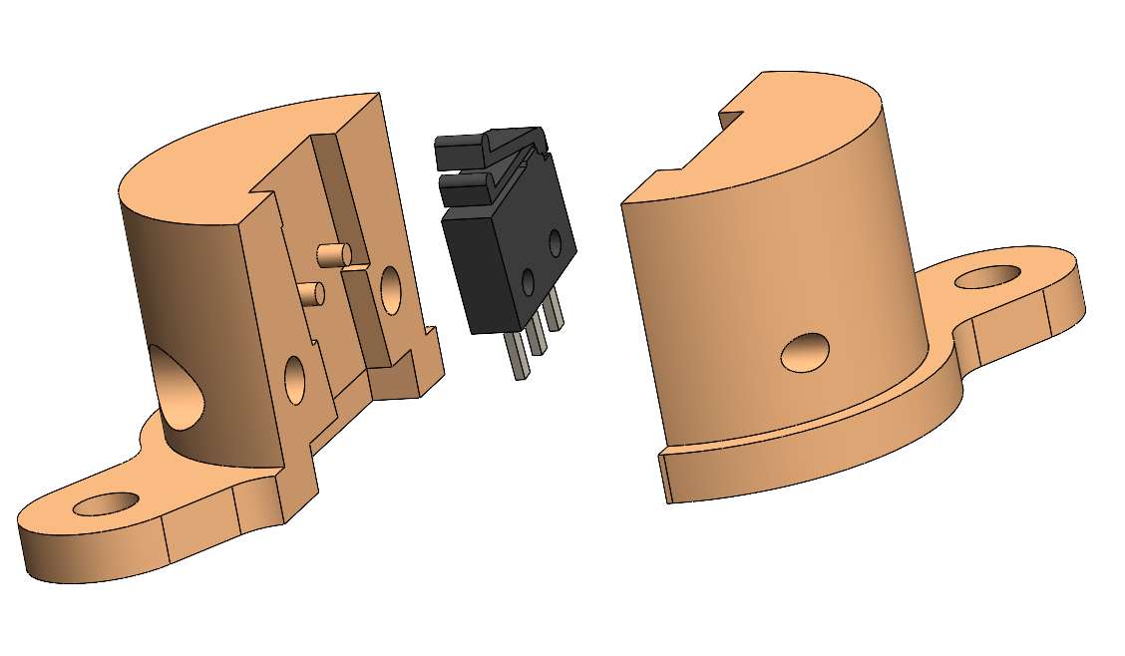
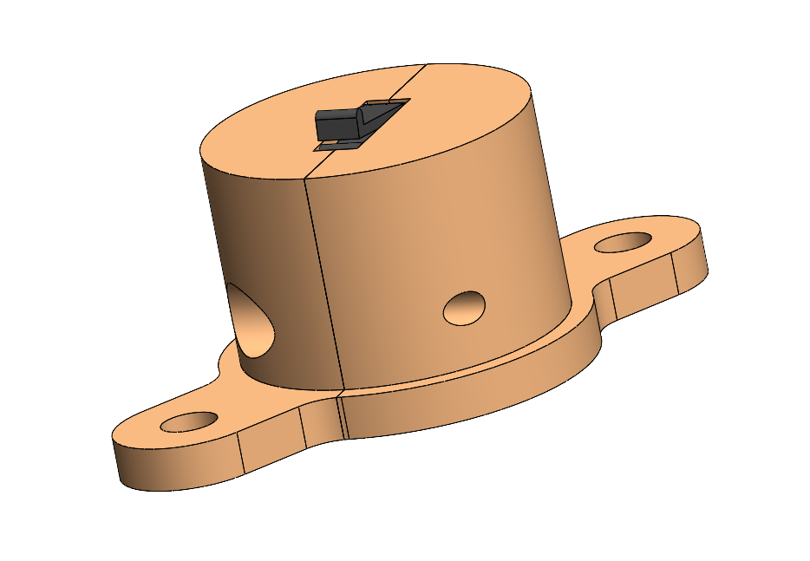
Micro-switch Mount for Slot Switches
Drill 0.75 inch hole in playing surface. Insert Part, making this surface flush with playing surface
F22-PM-3023
Join halves with #2 machine screws, 0.25 inches long
Mount with 2 #4 Pan Head Wood Screws, 0.5 inches long

Slide 24
Score Board

Slide 25
Requirements and Ideas
Scoreboard Attached to rear of machine on pivots for transport
Scoreboard houses Monitor and Speakers
Scoreboard may house AC system, on/off switch, computers?
Scoreboard has bright lights and Neo Pixels
Must provide Disconnect of wires between scoreboard and rest of machine

Slide 26
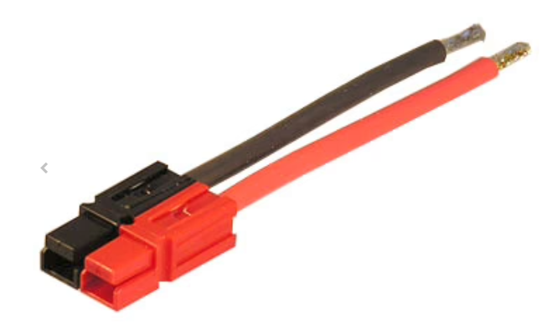
Wires in Scoreboard Disconnect
Purpose | Conductor | Max Current | Plug Type
48 Volt Supply | 12 AWG | 20 Amps | Anderson
12 Volt Supply | 12 AWG | 15 Amps | Anderson
5 Volt Supply | 12 AWG | 15 Amps | Anderson
Ground | 12 AWG x 3 | 50 Amps | Anderson
Computer Control | 24 AWG Stranded, x4 | I2C + Logic Power | MicroFit-4Pin

Slide 27
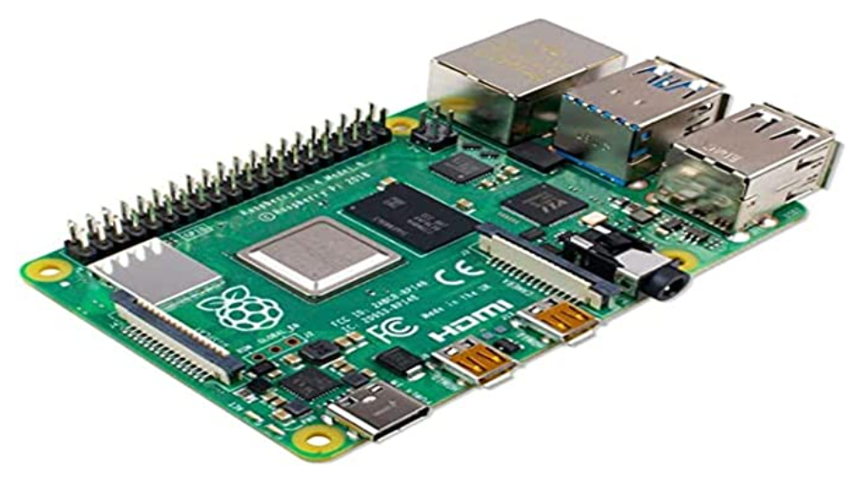
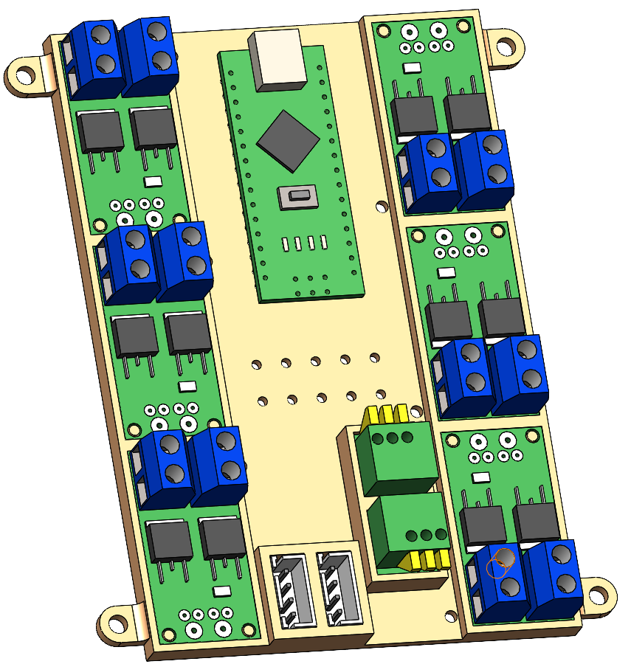
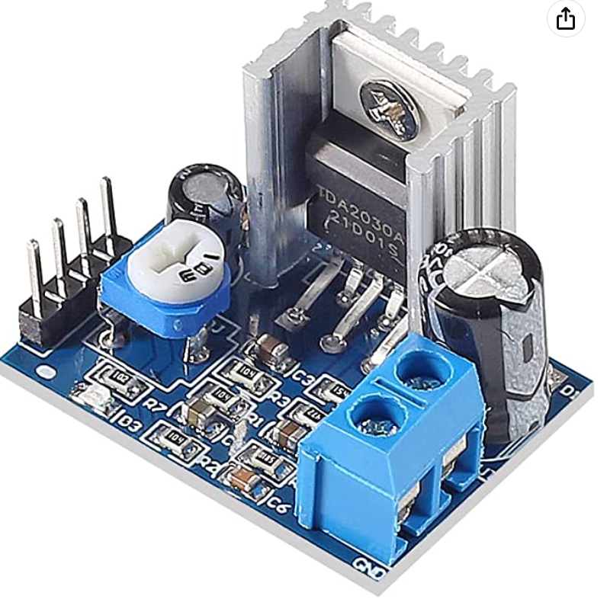
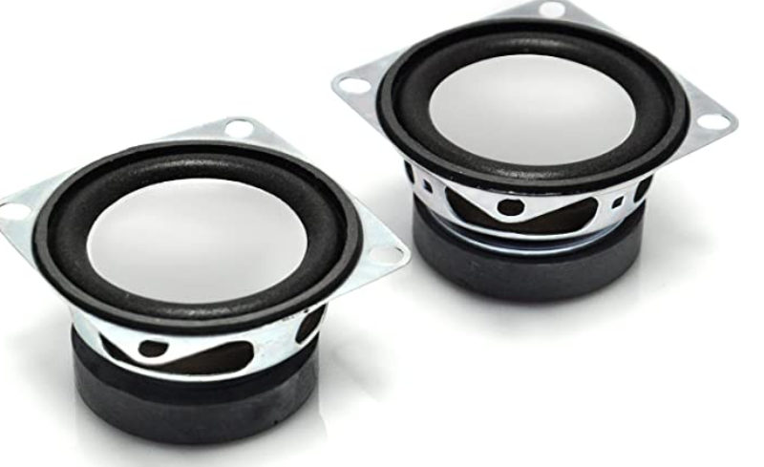
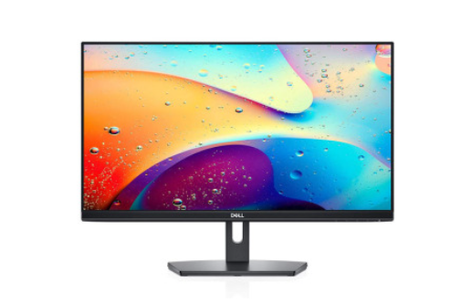
Block Diagram of Control Circuitry
Control Cable
2 wires for the RS-485 Bus
2 wires to carry +7 volt power
Daisy Chained Control Cable
Raspberry Pi
Various Microprocessor Nodes
Amplifier
Microprocessor Nodes, Responsible for:
Sensing Switch Inputs
Controlling Coils and Magnets
Controlling 12v Lamps
Controlling Neo Pixels
Speakers
Computer Monitor
(Built into Score Box)

Slide 28
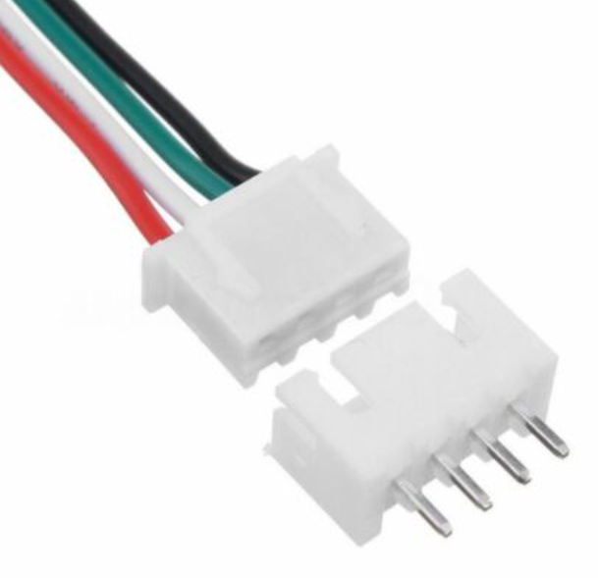
Control Signal Wiring to all Microprocessor Nodes
Use I2C bus -- Later can use CAN physical layer for increased robustness
Send Logic Power (+7 volts) with Data Signals
Use JST connectors…
Each Node does a pass through for all signals and power
Superseded cause I2C Sucks!
+7v Power
SDA
SCL
Logic Ground
These wires should be stranded, 18-24 gauge
Cables between nodes made with
Female JST connectors
Each Node has daisy chained in/out
Male JST connectors

Slide 29
Implementing a Robust Comm Bus
Use RS-485
According to Wikipedia, good to 50 meters at 2 Mbits/s, and up to 10 Mbits/s at shorter distances, such at 2 meters in the pinball machine. We only need about 100 KHz.
Uses differential signaling over twisted pair
One twisted pair means half duplex communication.
Can be implemented with the MAX485 chip for less than $1/node

Slide 30
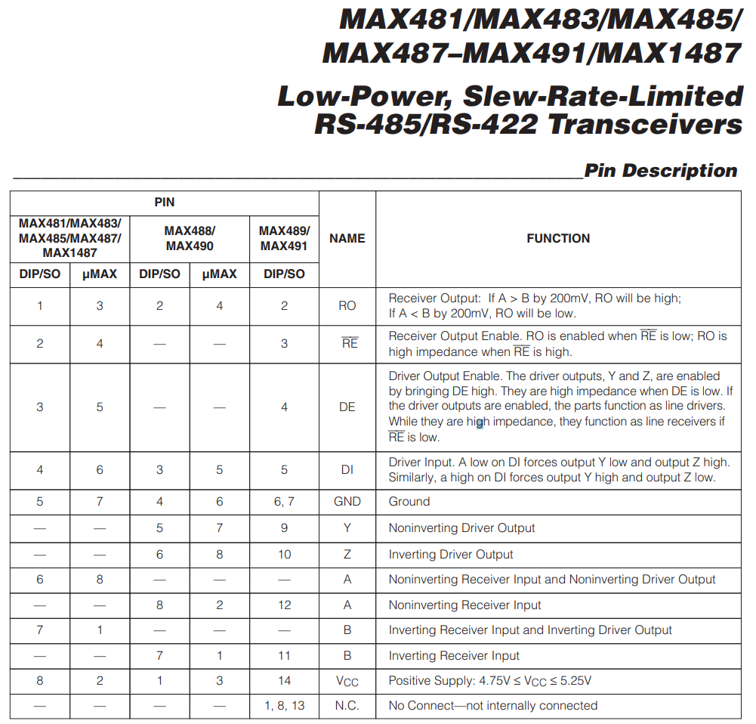
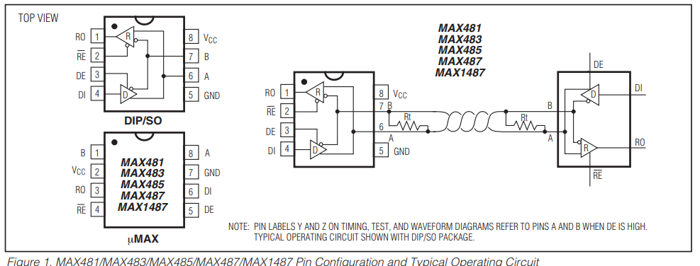
Data on MAX485 chip

Slide 31
Data on MAX485 chip
Vcc is 5v
We need to terminal the twisted pair at each end with a 120 ohm resistor.
Vcc is 5 volts, so we need to level shift for Raspberry Pi on R0.
However, V-high is 2 volts, so Pi can drive DI direct.

Slide 32
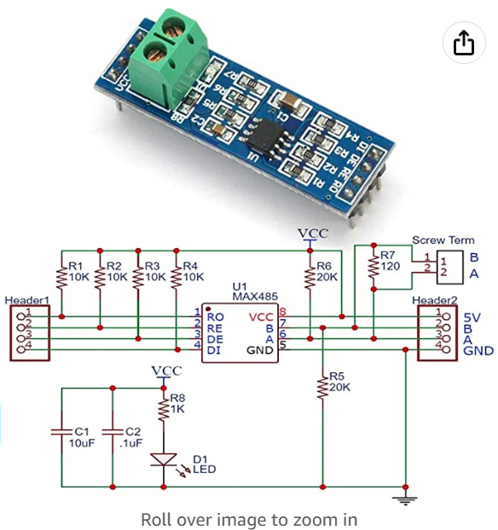
MAX485 Module from Amazon
Vcc = 5 volts
V-high on DI, DE, and RE >= 2.0 so Pi Logic levels will be okay.
Possible Modifications:
Note there is a 120 ohm resister already across the A and B lines. This resistor should be removed on all nodes except the Pi and the last node.
For the Pi Node, the pullups may interfere with the level shifting needed. Therefore, remove them all (R1-R4).
$1.10 each

Slide 33
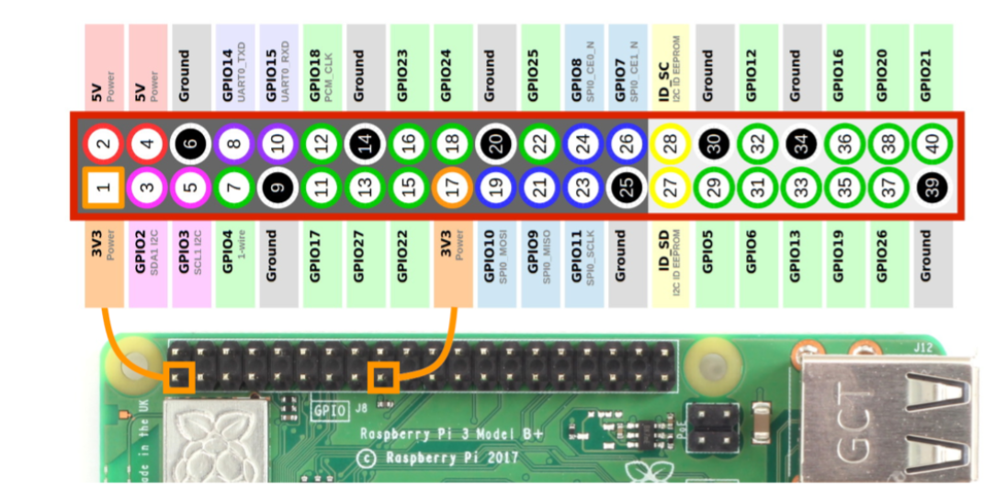
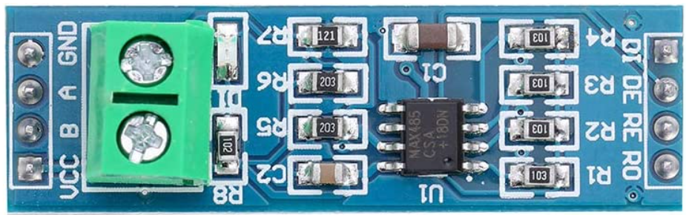
A Communications Bus for the Pinball Machine
Must be able to disconnect these wires for programming.
Remove these resistors for Pi node.
RX
1K
2K
TX
Transmit Enable on Low
Vcc
2K
Gnd
(The secret to using this bus is for only one node to transmit at a time. When a node needs to transmit, it lowers the DE signal to enable its transmitter. In our case, the PI will be responsible for telling the other nodes to transmit.)
Remove this resistor in middle nodes.
Twisted Pair, Much like CAN bus
Our baudrate will be set for 115200 bits per second.

Slide 34
Estimate of Nodes Needed
Node Name | Inputs | Outputs | Comments
Light Control Unit | None | NeoPixels, 6x Lamps | To be used in the Scoring Box for Lights
Light Control Unit | None | NeoPixels, 6x Lamps | To be used under playfield to control all NeoPixels, Panic Light, And Other Decorative Lights
Bumper Control Unit | Bumper Contacts (x3) | Bumper Coils (x3) Bumper Lamps (x3) | Controls all aspects of the three round bumpers in the center of the board
Flipper Control Unit | Flipper Switches (x2) Game Start Button (x1) | Flipper Coils (x3) | Controls all aspects of the flippers
Kicker Control Unit | Kicker Switches (x3) Hole Senser Switch (x1) Ball Ready for Load (x1) | Kicker Coils (x3) Drop Hole Coil (x1) Ball Load Coil (x1) | Controls Kickers, Drop Ball and Coils for returning the ball into play
Switch Input Unit | Micro Switches (Approx x20) | None | Senses all remaining micro switches.

Slide 35
Heart of Control System: Raspberry Pi
Power with these two pins.
Be sure to get polarity correct!
Pin 4 = + 5 Volts, Regulated, at least > 2 Amps
Pin 6 = Logic Ground, 0 volts
SDA = Pin 3 = Yellow or White
SCL = Pin 5 = Green or Blue

Slide 36
Light Controller Unit -- Requirements
Two similar units needed: Scoreboard and Playfield
Features: Controls 6x 12v LED lamps, and one Neo-Pixel Strand
Inputs:
12v, 5v, GND -- Spring Terminals
I2C in (4 Conductors) JST
Outputs:
I2C out (4 conductors) JST
Pos, Neg x6 for Lamps – Screw Terminals
Neo Out (3 conductors) – Spring Terminals

Slide 37
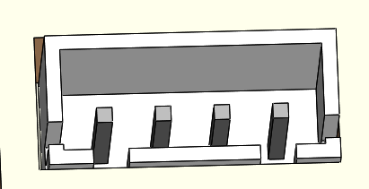
Light Controller Unit (LCU)
Lamp 6
Lamp 5
Lamp 4
NeoPixel
Black = Gnd
Red = 5v
Yellow = Data
Power:
Orange = 12v
Blue = 5v
Black = Gnd
18 Gauge Stranded Wire
Data Bus & Logic Power Connectors
+7v Power
SDA (to A4)
SCL (to A5)
Logic Ground
Lamp 1
Lamp 2
Lamp 3

Slide 38
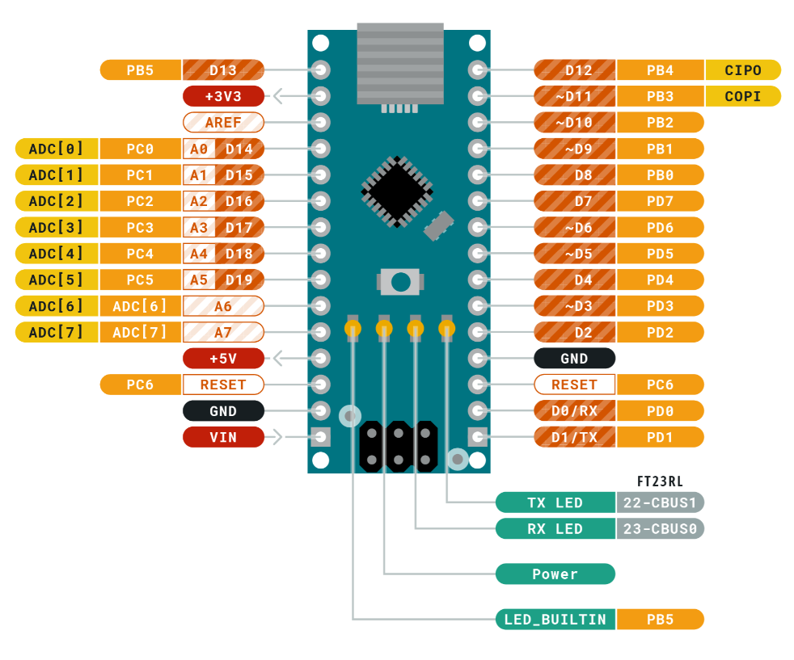
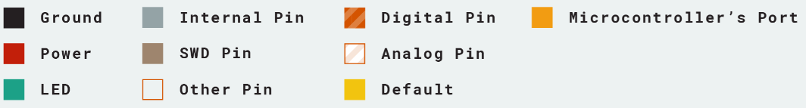
Arduino Nano Pinout

Slide 39
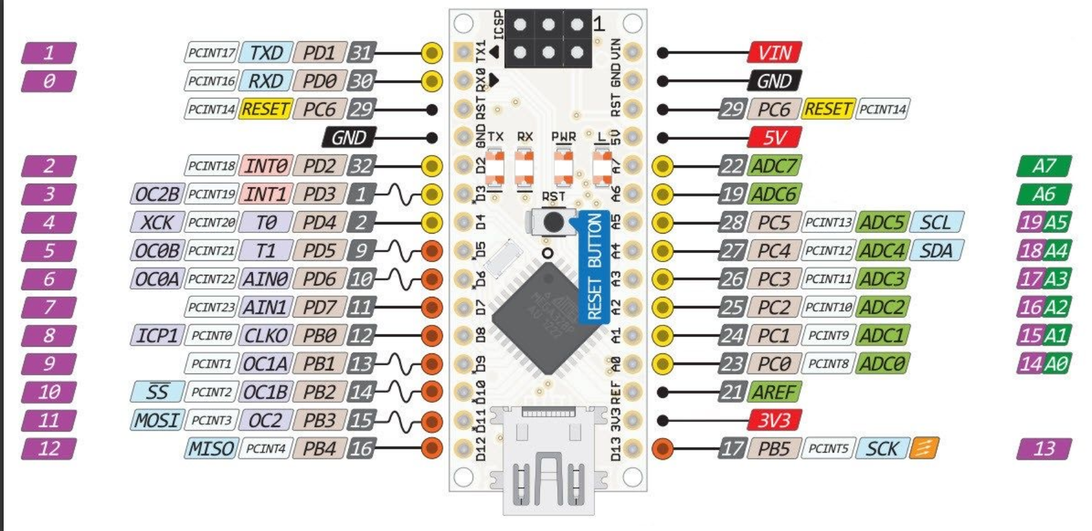
Arduino Nano Pinout

Slide 40
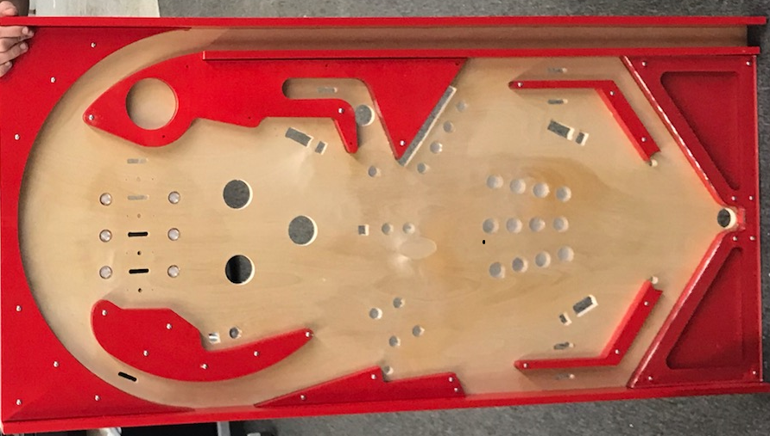
Feature Layout and Designations
1
1
Neo Pixel
10
Lane Switch
4
1
1
6
3
18
9
12
External Button
11
17
1
1
2
2
6
1
16
1
Target
1
8
15
1
19
20
22
3
2
6
23
1
Kicker
1
3
5
13
14
24
25
26
27
2
3
5
2
1
31
Flipper
2
29
30
1
4
4
28
1
Jet Bumper
11
9
3
3
7
7
12
1
10
8
Panic Light
3
5
7
2
(Editable Version)

Slide 41
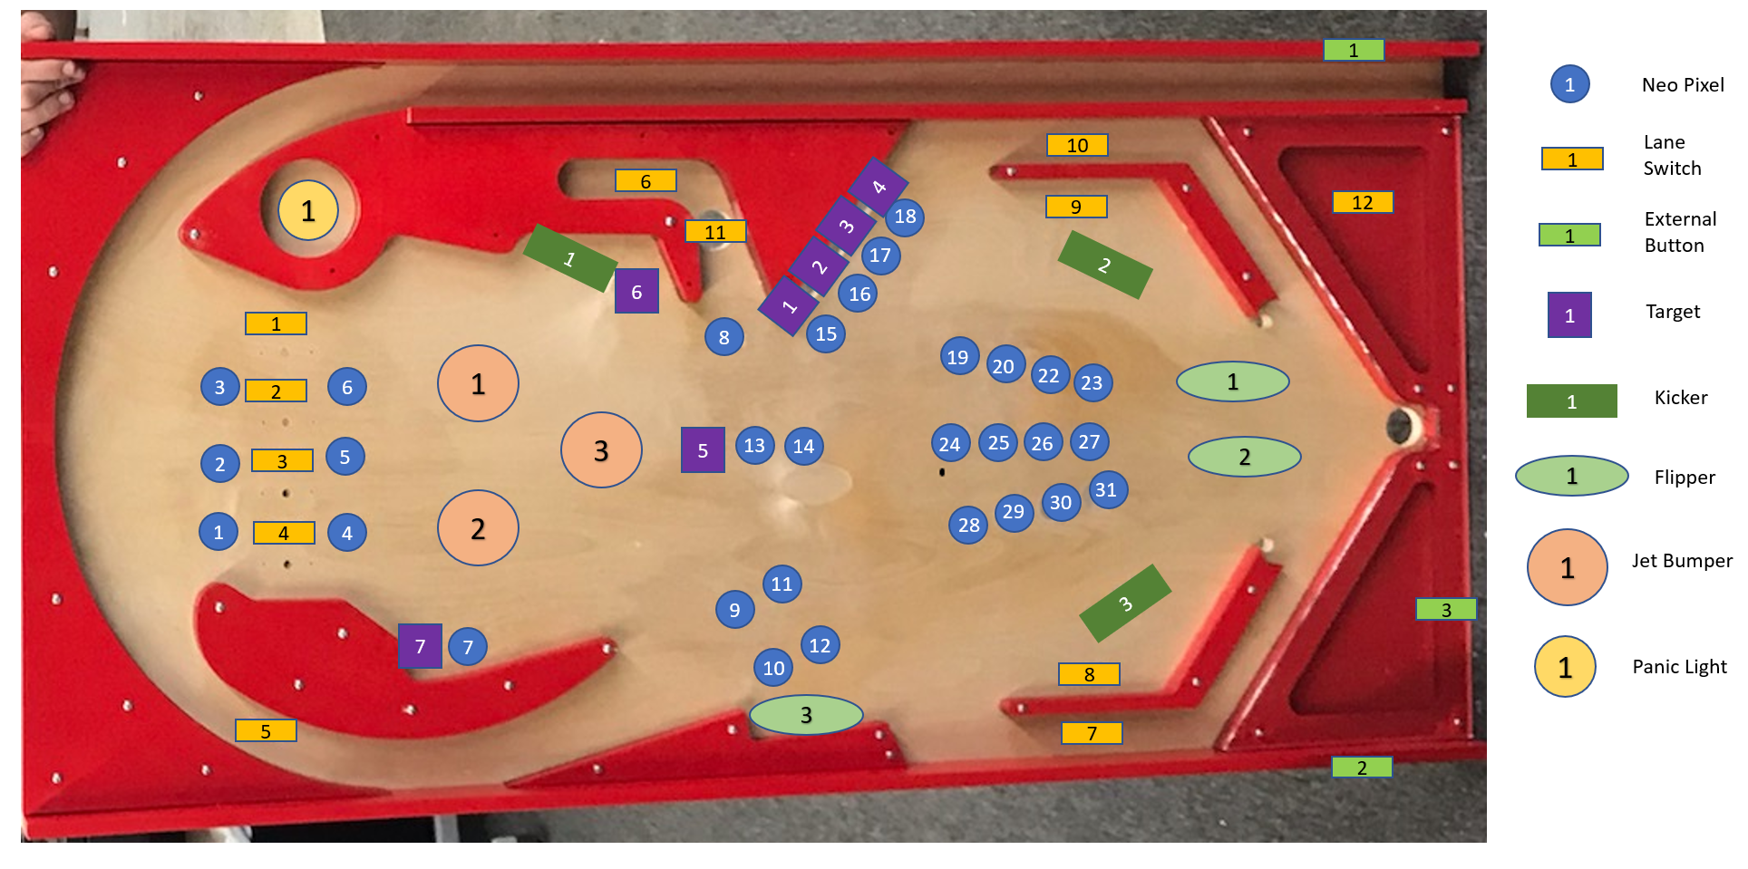
Feature Layout and Designations
(Fixed Version)

Slide 42
Game Play Sounds
Welcome to the Game Debue – Study the Game with the Jet Bumpers
Build Season Starts! -- You have 6 Weeks!
Hit all the EPIC targets to make a better robot
Don’t Hit the Panic Button!
5 Weeks to Go. Hit the Targets in Order for the Best Robot
4 Weeks to GO! Hurry, Hurry. Hit more targets!
3 Weeks to GO! Hurry, Hurry Hurry! Hit More targets!
2 Weeks to GO! HURRY! MORE, MORE, MORE,
1 Week to GO! Your almost out of TIME. HURRY! But Don’t Panic!
Its TIME TO PANIC – Parts are out-of-stock!
Its TIME TO PANIC – CNC isn’t finished!
Its TIME TO PANIC – CAD is not ready!
Its TIME TO PANIC – Programmers are sick!
Its TIME TO PANIC – Your robot is trash!
Welcome to Competition! Cash in with your Robot!
Hit the Targets to get ranked.
Climb the Ramp for more ranking points!
You Made it to PLAYOFFS!
Get selected with the Jet Bumpers.
You are seeded #47 – Hit the PANIC or go home!
Too bad, you didn’t get selected.
You are seeded #8 – good luck!
You are seeded NUMBER ONE!
Use your scouting data at the Jet Bumpers to select your team!
FOUL! – Frame Out of Bounds
FOUL! – Illegal Contact
FOUL! – Human Player Violation
FOUL! – Overweight
RED CARD! -- (For no discernable reason!)

Slide 43
Nodes
Node Name | Node Function | Address | Inputs | Outputs
Lights – Socre Box | Lights in Score Box | 2 | None | Neo Pixels 6 Lamps
Lights – Playfield | Lights in the Playfield | 3 | None | Neo Pixels 2 Lamps
Flippers | Flippers | 4 | 6 Switches | 6 Coils
Bumpers | Jet Bumpers | 5 | 3 Switches | 3 Coils 3 Lamps
Kicker | Sling Shot Kickers | 6 | 3 Switches | 3 Coils
Lane Sensors | Lane Switches | 7 | 15 Switches | None
Targets | Target Switches | 8 | 8 Switches | None
Test | Debugging Comm Bus | 9 | NA | NA

Slide 44
Node Pins VS Outputs
For the “Lane Sensor” Node
Function | IO Pin
S1 | A0
S2 | D11
S3 | D10
S4 | D9
S5 | D8
S6 | D7
S7 | D6
S8 | D5
S9 | D4
S10 | D3
S11 | A1
S12 | A2
S13 | A3
S14 | A4
S15 | A5
For the “Lights” Node
For the “Target” Node
Function | IO Pin
Neo Pixels | D12
Panic Light | D6
Spare Light | D5
Function | IO Pin
S1 | D4
S2 | D7
S3 | D8
S4 | A0
S5 | A1
S6 | A2
S7 | A3
S8 | A4
For the “Kickers” Node
Function | IO Pin
K1 | D6
K2 | D5
K3 | D3
SW 1 | D4
SW 2 | D7
SW 3 | D8

Slide 45
Node Pins VS Outputs
For the “Flippers” Node
Function | IO Pin | Expected Usage
F1 | D6 | Right Flipper Coil
F2 | D5 | Left Flipper Coil
F3 | D3 | Third Flipper Coil
X1 | D11 | Lift Motor
X2 | D10
X3 | D9
EX Button 1 | D8 | Right Flipper Button
EX Button 2 | D7 | Left Flipper Button
EX Button 3 | D4 | Start Button
Ball 1 | A0 | First ball to play, next to lift gate
Ball 2 | A1 | Second ball position
Ball 3 | A2 | Third ball position
Ball 4 | A3 | Lost ball entry position
Extra Input | A4
Ball Cycle | D12 | Controls Ball Servo
For the “Jet Bumpers” Node
Function | IO Pin
B1 | D6
B2 | D5
B3 | D3
SW 1 | D4
SW 2 | D7
SW 3 | D8
L1 | D11
L2 | D10
L3 | D9

Slide 47
Animation and Score Board

Slide 48
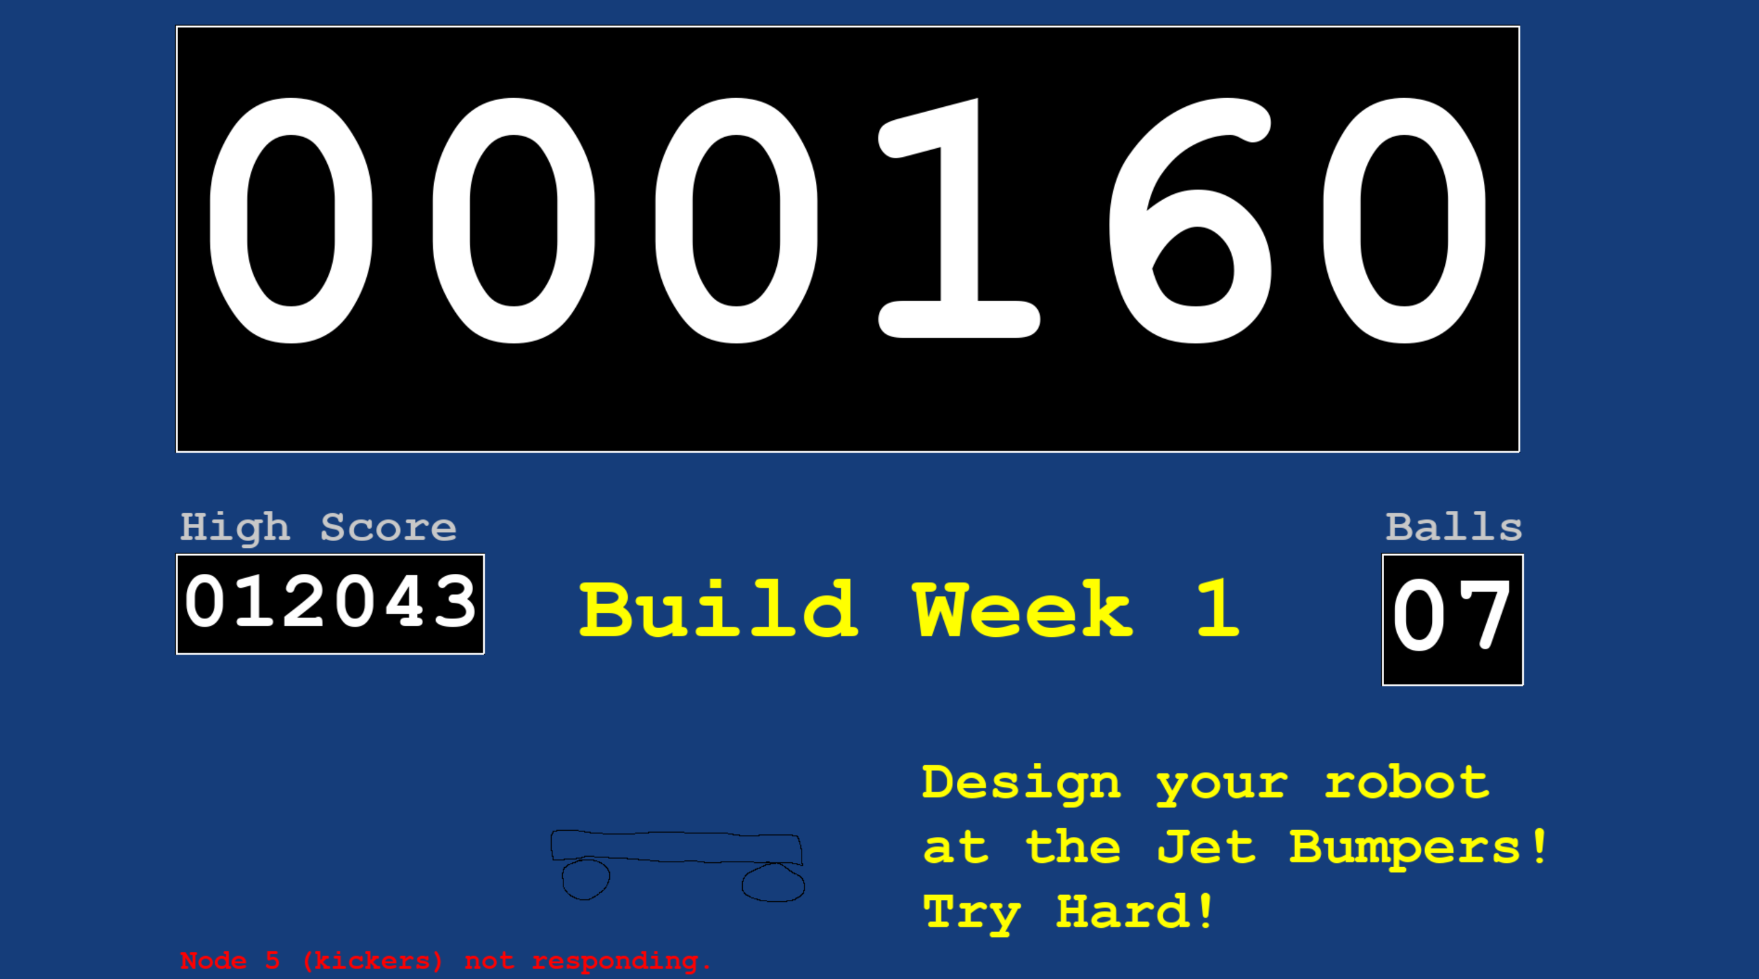
Animation Goes HERE

Slide 49
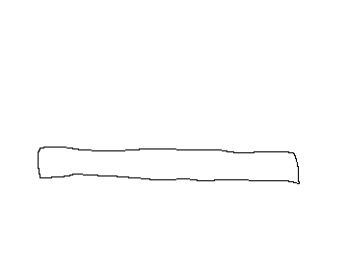
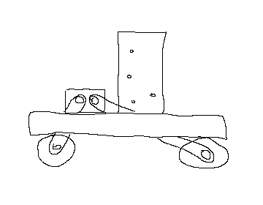
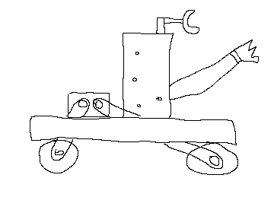
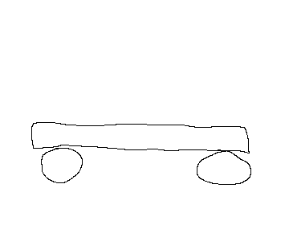
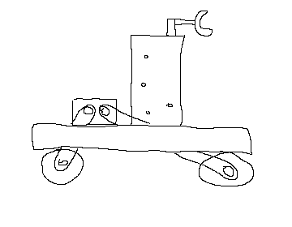
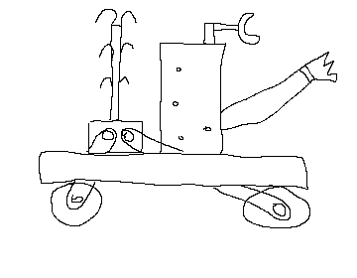
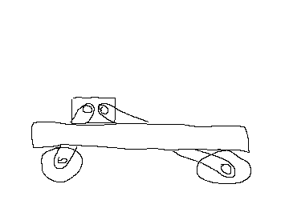
1:
4:
6:
2:
5:
7:
3:

Slide 50








Slide 51
Ball Trough
Sensors and Control to Deliver Ball into Game

Slide 52
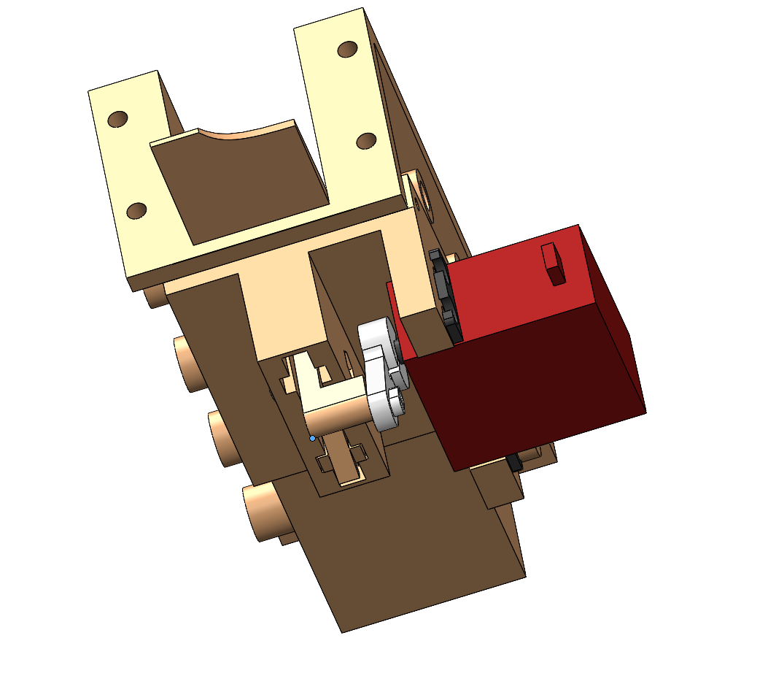
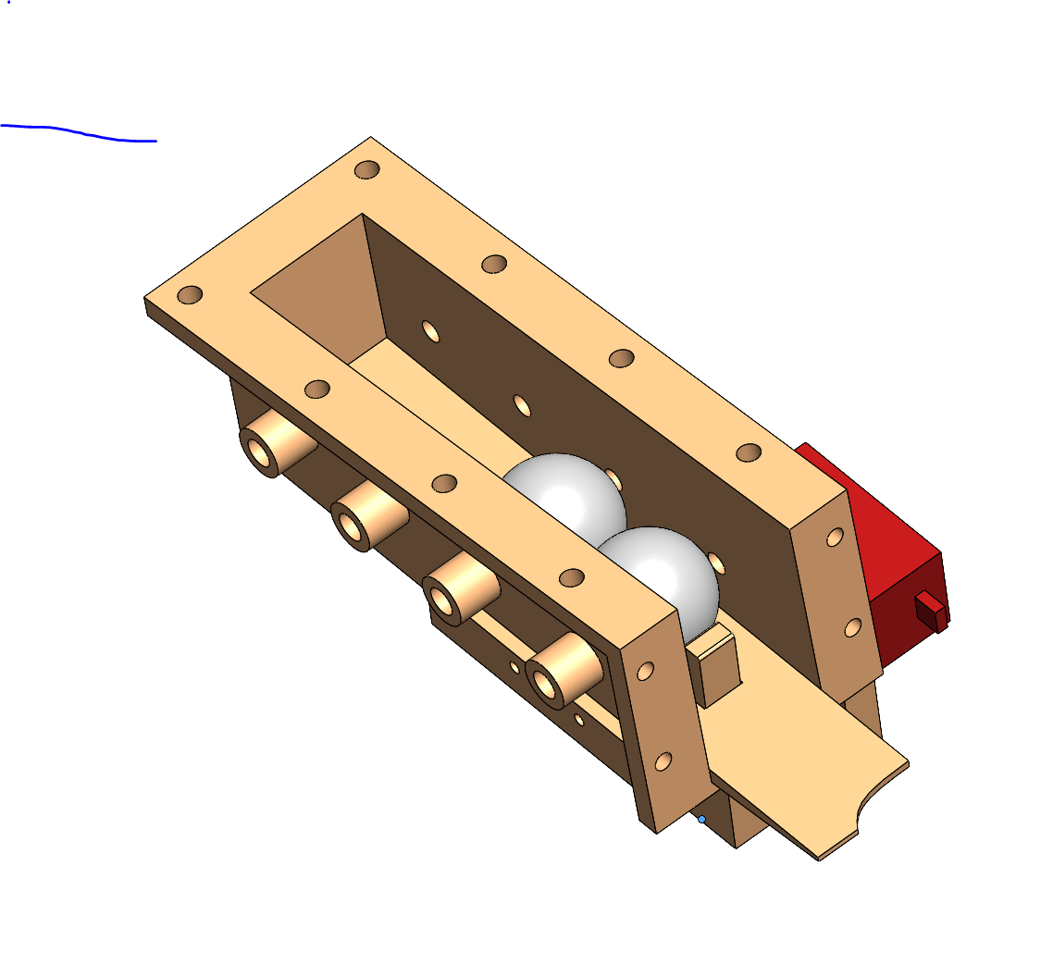
Ball Trough Mechanics
Balls enter here upon leaving
The play field.
Servo to Control
Ball Regulator
Ball Regulator Post
Balls exit here under
computer control. They
Are then delivered to the
Riser Screw.
IR Sensors To
Tell Computer
How many balls
Are in the Trough

Slide 53
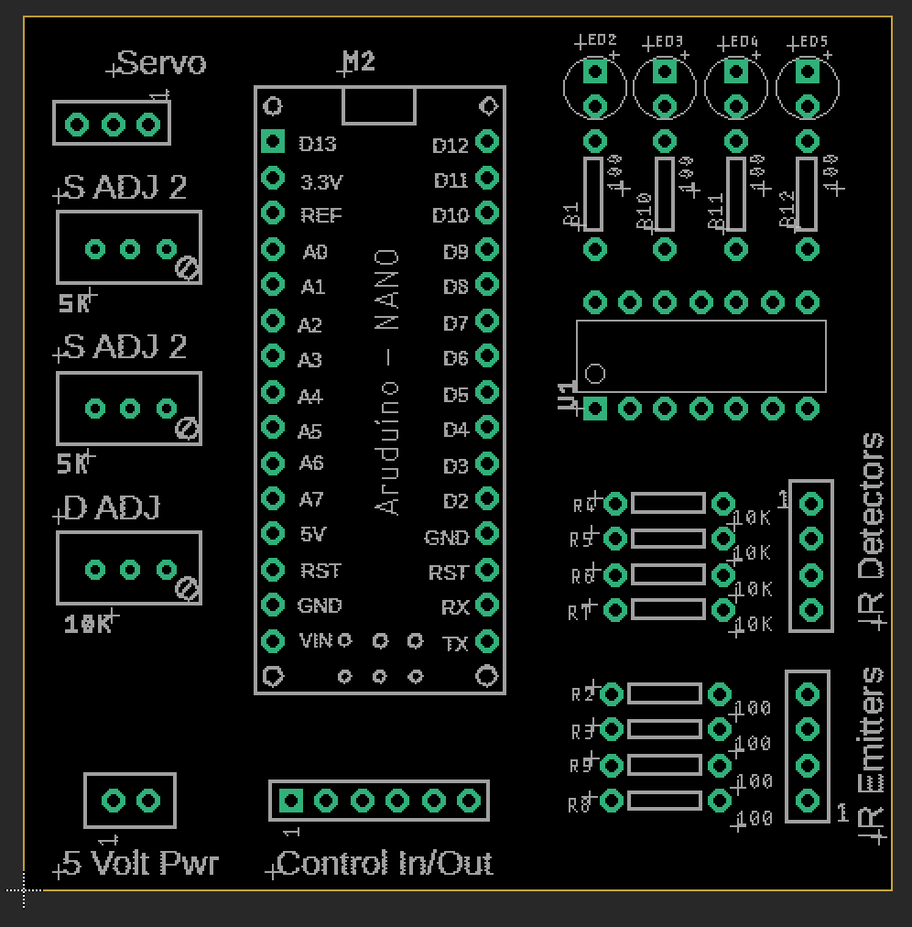

Circuit for Ball Trough, PCB LAYOUT
Top Side View
Under Side View

Slide 54


Circuit for Ball Trough, PCB LAYOUT (With Airwires)
Top Side View
Under Side View

Slide 55

Circuit for Ball Trough, V1

Slide 56

Circuit for Ball Trough, V2
Note: Much simpler to build. The V1
Circuit didn’t work well cause the
Inputs to the ADCs were unstable which
Lead to jittering on the servo.
Instead, we hard-wired the servo limits into
The code.
Also, instead of using a op-amp to do
threshold compare, just use the ADC on
the nano. It was found that the input
swing is very wide for a break in the IR beam.

